Slide 1
ACADEMIC MISCONDUCT
Don’t do it!

Slide 2
Don’t do it!
“Any activity that tends to compromise the integrity of the University, or subvert the educational process”

Slide 3
I sit on the committee…
We had 800 cases last year
With technology, it gets easier and easier for students to cheat
It also gets easier and easier for us to catch them

Slide 4
Examples of violations
Violation of course rules
Read the syllabus!
Some professors expect you to work in groups, some forbid it! Find out.
Can you bring a sheet of equations to the exam? Find out!
Violation of program regulations

Slide 5
Another violation
Knowingly providing or receiving information during an exam or assignment
Even if you can see that person’s exam, don’t even look in that general direction!
If it looks like you may have been looking, the instructor is REQUIRED to report it
If it looks like you are tipping your exam so someone else can see it, that’s just as bad
If you tend to look around the room absent-mindedly during and exam, sit in the front row

Slide 6
Another kind of violation
Possession and/or use of unauthorized materials
When they tell you to put your phone away, put it AWAY away!
Just having it nearby, even if off, can be enough to suspect you
Put it in a bag or something under your chair

Slide 7
Another kind of violation
Knowingly providing or using assistance in the lab, field work, or course assignment, unless such assistance has been specifically authorized by the instructor
If the professor says you can work together, you can ask a friend
Otherwise, DO NOT
That includes your good friend Google

Slide 8
Submission of work not performed in a course
Includes falsified data
Includes submitting work you did for one course in another course (even a course you took at another university! Yes, we have seen it!)
Also, if you repeat a course, you must do all the assignments anew, fresh!

Slide 9
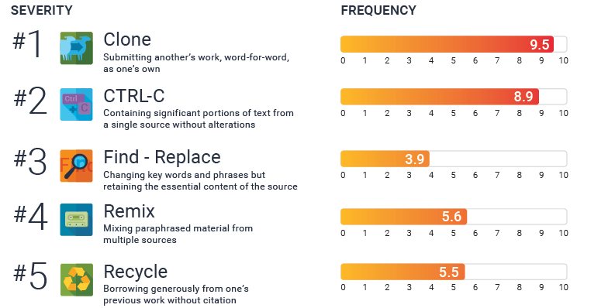
Plagiarism
https://www.turnitin.com/infographics/the-plagiarism-spectrum

Slide 10
Do not even plagiarize yourself
That’s the same as resubmitting the same work for multiple assignments

Slide 11
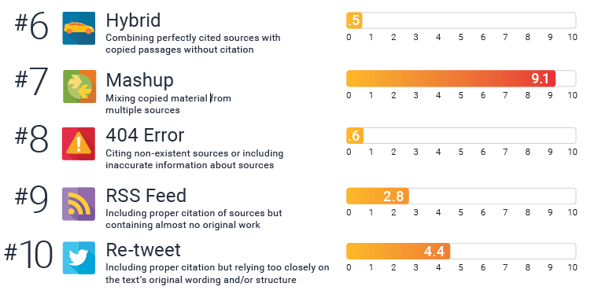
Plagarism
https://www.turnitin.com/infographics/the-plagiarism-spectrum

Slide 12
Turnitin (for example)
There is software out there that compares what you turned in to
Every other assignment ever turned in for that course
Anything online
Including so-called “homework” sites
Instructor gets a full report showing the sources, what is the same, the percentage overlap…
Instructor is REQUIRED to report if it is too similar
You can use this yourself to make sure you aren’t too close to the original- even originals you’ve never seen

Slide 13
False!
”If it’s not copyrighted, it’s OK to copy it”
It’s still not your work!
Citing is FREE! Just do it!
Don’t forget this applies to images, not just text and equations

Slide 14
Examples
You present a derivation in your dissertation. You change the words, maybe even the notation, but the steps and logic are the same.
You must cite the source- the logic and thought is not yours
You use a table from someone else’s paper, but you change the font and the colors of the lines
Cite it- it’s still someone else’s work
If you add rows, make it clear what is the other person’s data and what you have added
If you delete rows, use “After…” and cite it
You see a great picture that perfectly illustrates your point. You redraw it a little, but it’s essentially the same idea
Just use the original and cite it! If you redraw it, say “After XYZ” where XZY is the citation

Slide 15
Other violations
Falsification, fabrication, or dishonesty in conducting or reporting laboratory or research results
We see this all the time- sometimes students submit lab reports describing an experiment that was done last semester but isn’t in the current course- FOOL!
Sometimes students think it is important to obtain the expected results- but the instructor may know something you don’t know, some reason why this experiment always gives a surprise result or the reagent has expired to it is not possible for the experiment to “work”
Don’t take a chance! Report your results honestly

Slide 16
Other violations
Serving as or asking someone else to serve as a substitute while taking an exam
Alteration of grades in an effort to change eared credit or a grade
Alteration and or unauthorized use of university forms or records

Slide 17
Homework sites
Watch out, they are very sneaky!
They may offer “examples” or “homework help” or even “online tutoring”
Some pretend to offer scholarships in exchange for YOU to upload YOUR homework for them to turn around and sell to others.
Don’t do it! Steer very clear of those sites

Slide 18
Uploading material to homework sites
It is Academic Misconduct to upload your assignments to these sites
Even if no one ever uses it
Even if you get nothing in return
Just providing it is a violation of the Code of Student Conduct

Slide 19
Why do people cheat?
Some people are just sleazeballs
Sometimes, though, even nice people get in a panic
They are behind and running out of time
This assignment is REALLY important
Whatever, whatever, whatever
Don’t give in to temptation! Better to get a bad grade than thrown out of the university

Slide 20
“Bob” has a minor academic misconduct violation
Forgot he had other tabs open in his browser while taking an online exam
Didn’t use them, and can even prove it
But they were there, violation of course rules, eve though he didn’t actually cheat
Bob had hoped to ask this instructor to be his PhD advisor
Prof. X is not going to take him on

Slide 21
So Bob asks Prof Y
Y asks X “Why didn’t you take Bob into your lab?
Prof. X can NOT discuss your case with anyone
But he can just say something like “I don’t recommend this student to you.”
Now Bob has little chance of finding an advisor
Even though his infraction was minor, he ends up leaving the university anyway

Slide 22
What happens if you are suspected
We are required to report any suspected cases of Academic Misconduct to a university Committee
We can NOT make a judgement based on anything you say later, only the Committee can decide
If an instructor accuses you of AM and says “I’ll just give you a zero this time…” then you can report HER to the Committee

Slide 23
Once reported
You will meet with the coordinator
You have the option to take an “Administrative Decision” and he decides the penalty
Or, you can request a hearing
The instructor provides their evidence
You tell your perception of the incident
The committee asks you both questions
The committee decides ”in violation” or “not in violation”
Know that the Committee is conscientious and careful- many people are found to be NOT in violation after hearing the evidence from both sides

Slide 24
What can happen if you’re found in violation
There are two kinds of sanctions (you will get both)
Disciplinary Sanction (warning, probation, etc.)
Grade Sanction (could be zero on the assignment, reduction of the final course grade, suspension for one or more terms, dismissal from the university, or a combination

Slide 25
Final comment
Of course no one says academic misconduct it OK
But, in some cultures, it is understood that if someone has the chance to cheat they will, that “everyone does it,” or that they can bribe or talk their way out of it later
At Ohio State, we take this stuff VERY seriously- don’t test us

Slide 26
And that’s why your degree means something!

